Slide 1
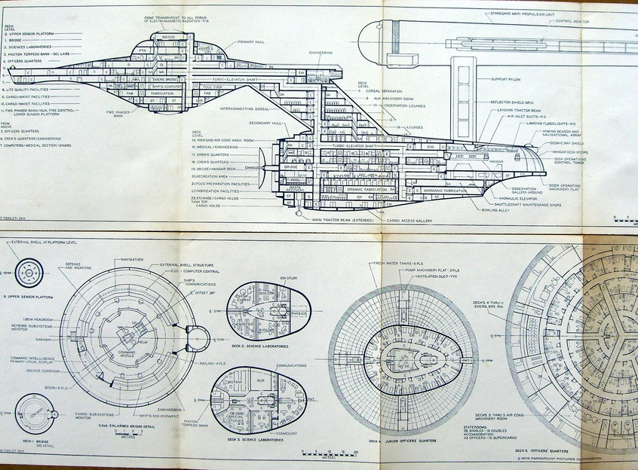
Diagram Notations
http://www.flickr.com/photos/cardoso/2197507288/

Slide 2
Did you plan to build the Enterprise all on your own????
Diagrams are often useful when…
You need to communicate, visualize, or analyze something
And that something has some sort of structure

Slide 3
Typical parts of requirements documentation
Functional requirements
Unstructured text
Use cases (diagrams – UML)
Non-functional requirements
Unstructured text
Fit criteria
Diagrams
Class diagrams (UML) and entity-relationship diagrams
Dataflow, sequence (UML), and state diagrams (UML)
References (on canvas):
Textbook, parts of Chapter 4 on Notation
UML distilled chapter 16
Notes:
We are going to discuss a lot of diagrams today.
Most have their own syntax – so you will be bombarded with information. Handouts, that collects these syntaxes and example diagram for easy references – these are from the slides.

Slide 4
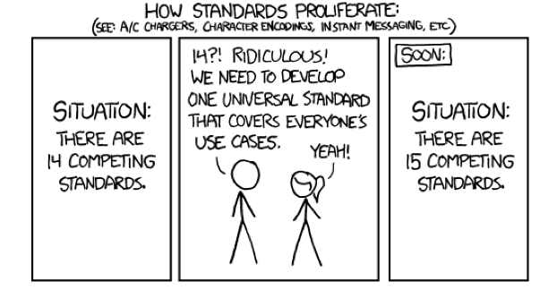
Standards
© http://xkcd.com/927/

Slide 5
Unified Modeling Language
Developed by: Grady Booch, Ivan Jacobson, James Rumbaugh
Many notations for describing OO Analysis / Design
UML integrates those notations
Supported by many tools (e.g., Rational)

Slide 6
UML
Set of MANY (visual) modeling techniques
Static Views
Use case diagrams
Class diagrams
Object diagrams
Component diagrams
Deployment diagrams
Dynamic Views
Sequence diagrams
Collaboration diagrams
Statechart diagrams
Activity diagrams

Slide 7
Use Case Diagram
System
Boundary
Actor
UseCase
“Participates-In” association
Notes:
To create use cases, you will first identify the scenarios under which the system will be used

Slide 8
Include
Base Use Case
Create new blog
acct
Create new wiki
acct
Factors use cases into additional ones
<<includes>>
<<includes>>
<<includes>>
Included Use
Case
Check Identity
Notes:
Includes in entirety

Slide 9
Generalization
Customer
Actor
Generalization
Special
Actor
Special
Actor
Commercial
Customer
Residential
Customer

Slide 10
Generalization
Create new regular
blog acct
Create new editorial
blog acct
Create new blog
acct
Create new wiki
acct
<<includes>>
<<includes>>
Check Identity

Slide 11
Notes on use case diagrams
Stick man for user
Ovals for use cases
Italicize “abstract” use cases
Simple arrows when a Use Case “calls” another
Open arrowheads for specialization
Similar to the role that sub-classing plays in OO

Slide 12
Use case diagram: shows activities supported by the system
UC#1: Report repression
UC#2: Clarify tweet
Repressed citizen
UC#3: View reports
Concerned public
UC#3a: View on map
UC#3b: View as RSS feed

Slide 13
Class Diagram
Abstraction of entities with common characteristics
Entities have three basic components:
Class name
Attributes
Operations
Associations depict relationships between classes, and include:
Multiplicities
Aggregation
Generalization
Name
TariffSchedule
zone2price
getZones()
getPrice()
Attributes
Instance
Operations
tariff_1974:TarifSchedule
zone2price = {
{‘1’, .20}, {‘2’, .40},
{‘3’, .60}}

Slide 14
Class Diagram: Multiplicity
Potential values:
1 – exactly one instance
0..1 – no instance, or one instance
0..n – zero to n instance
1..n – one or more instance (at least 1)
* == n
Multiplicity indicates how many objects
may participate in an association
Class
Multiplicity
Association
SimpleWatch
1
1
1
1
2
1
2
1
PushButton
state
push() release()
LCDDisplay
Battery
load()
Time
now()
blinkIdx
blinkSeconds()
blinkMinutes()
blinkHours()
stopBlinking()
referesh()
Attributes
Operations

Slide 15
Aggregation
An aggregation is a special case of an association denoting a “consists of” hierarchy
The aggregate is the parent class, the components are the children classes
Exhaust System
Part-Of
1
1..2
Muffler
Tailpipe

Slide 16
Generalization
Generalization denotes inheritance
Children inherit attributes and operations of parent
Generalization eliminating redundancy
Button
is-a, kind-of
CancelButton
ZoneButton
Notes:
36

Slide 17
Class Diagram (example)
Visibility
+ public
# protected
- private
/ derived
$ static
Person
+ name : String
- ssn : String
# birthday : Date
/ age : int
Visibility AttributeName:Type = Initial Value
Visibility MethodName (Parameter List) : Return-List
+getName : String
-calculateAge : int

Slide 18
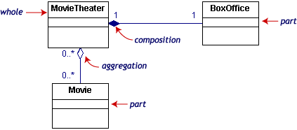
Class Diagrams
Simple Aggregation
Composite Aggregation
With composite aggregation, the
part object may belong to only one
whole, and are expected to live and
die with the whole.

Slide 19
Class Diagrams (Advanced)
Can have self-relations:
manager
manages
employee

Slide 20
Notes on UML class diagrams
One box per kind of entity, listing attributes
Italicize abstract entities, attributes
Lines without arrowheads show references
Similar to member variables in OO
Labeled with cardinality (multiplicity)
Integers, ranges, or asterisk (for unlimited)
Lines with open arrowheads for specialization
Lines with regular arrowheads can be used to indicate dependencies
Usually omitted in requirements’ class diagrams
Diamond heads indicate aggregation, whereas solid diamonds indicate composition

Slide 21
UML class diagram: shows entities, attributes, relationships
Clarification tweet
+ report
+ when (datetime)
+ text (string)
User
+ Twitter username
Repression report
+ source (tweet)
+ location (geocode)
+ when (datetime)
+ details (string)
1
*
1
0..1
*
*
Repression tweet
+ user
+ when (datetime)
+ text (string)
1
Repression view
+ reports
*
Google map view
+ JavaScript
RSS View
+ XML text

Slide 22
ER Diagrams
Entity: real world objects with common properties & behavior
Relationship: between two entities
Attributes: cardinality,…
entity
0..1
relationship
1
entity
attribute1
…
…

Slide 23
ER Diagrams
Entity: real world objects with common properties & behavior
Relationship: between two entities
Attributes: cardinality,…
users
0..n
enter
1
zoo
ticket counter
entrance
…

Slide 24
Notes on entity-relationship diagrams (ERDs)
One box per kind of entity
List entity attributes on branches
Lines with a diamond show relationships
Diamond label indicates role of relationship
Numbers or variables on lines show cardinality

Slide 25
Entity-relationship diagram: shows entities, attributes, relationships
Clarification tweet
report
when (datetime)
text (string)
r
0..1
User
Twitter username
Repression report
source (tweet)
location (geocode)
when (datetime)
details (string)
p
1
yields
1
writes
asks about
shows
n
1
q
Repression tweet
user
when (datetime)
text (string)
Repression view
reports
Google map view
JavaScript
RSS View
XML text

Slide 26
Data Flow Diagram
Models functionality and the flow of data from one function to another
input
function
output
Actor (data sink)
data store

Slide 27
Notes on dataflow diagrams
Each oval is a “function” provided by system.
Each inward arrow is a parameter (labeled)
Each outward arrow is an output (labeled)
Each rectangle is an actor
A person, place, or thing that can do stuff and/or initiate events
Each “half-rectangle” is a data store
Often clearer if you do a separate dataflow diagram for each use case

Slide 28
Dataflow diagram: shows flow of information
Repression info
Report
Tweet
Reporter
Twitter DB
Send clar req
Tweet
Clarification message
Clarification message
Tweet
Inter-pret
Raw report
Clarify
Viewing user
Location
Geocoder
Map
RSS feed
Geocode
RSS View
Report
Reports
Reports DB
Map View
Reports

Slide 29
Sequence Diagrams
represents behavior in terms of interactions
Shows only one flow of control
Swimlane
Object : Class
or Actor
name
Lifeline
Focus of
Control/
Activation
message
Object
Destruction/
Termination
X
End of entity
specification

Slide 30
Conditional and iteration
[Guard] / [Iteration condition] Operation-Name (Arg-List)
recursion
[Guard] – if condition holds true operation performed
[Iteration condition] – iteration performed as long as
Guard condition holds true

Slide 31
Notes on message sequence diagrams
One box per entity involved
E.g.: if you have two users interacting with each other, then you would have two boxes
Each box has a dashed lifeline, showing its “lifetime”, which can end if an object is destroyed
Arrows show messages
Also, draw an arrow back if there’s a return value
Conditionals are written with brackets [ ]
Loops can be enclosed in a shaded box

Slide 32
Message sequence diagram: shows flow of control
Location
checker
User
Twitter
Database
Geocoder
Tweet event
Read tweets
Geocode
Create report
Request to clarify [if geocode == null]
Deliver request

Slide 33
UML State Diagrams
Describe how an object’s state changes in response to external events
Name
Normal State
Activities
Start/Initial State
Stop/Accepting/Final State
Transition
EventName [Guard] / Action
Notes:
Similar to State Transition Diagrams / FSMs
Nodes are states
Arrows are events/actions/stimulus
Bars are for synchronization control
State – The current status of an object based upon the total set of events it has responded to so far.
Transition – Associations between states. Transitions are fired (taken) based upon events that the object responds to.
Activity – Nonatomic sequences of actions that have some duration. (assumed to take time)
Action – Atomic executable statements that invoke an operation. (assumed to happen almost instantly)
Entry Action – Always performed on entering a state.
Exit Action – Always performed when the state is exited.
Do Activity– Performed continuously as long as the object is in the state
Include Action - Invoke the states internal state machine (Do not reference operations).
Event – Occurrences that may trigger an object to change states.

Slide 34
Notes on state charts
One box per state
Arrows show a possible state transition
Annotated to indicate under what conditions the transition occurs
Filled circle shows where you “start”
Nested filled circle shows where you “stop”

Slide 35
State chart: shows change over time
Report status
Raw (just text)
record
geocoding fails & user retweets
Geocoded (geocode != null)
In database (geocode == null)
geocoding succeeds

Slide 36
Putting it together: a typical requirements document
Requirements definition
Unstructured text: functional & non-functional reqs.
Use case descriptions
Class diagrams or ERDs showing external entities
Requirements specification
Unstructured text: functional & non-functional reqs.
Dataflow diagram
Message sequence diagrams or state charts

Slide 37
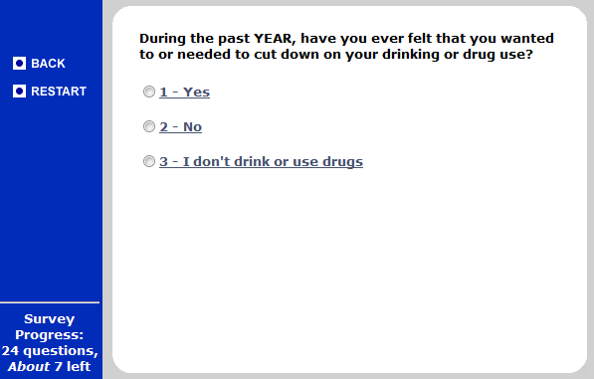
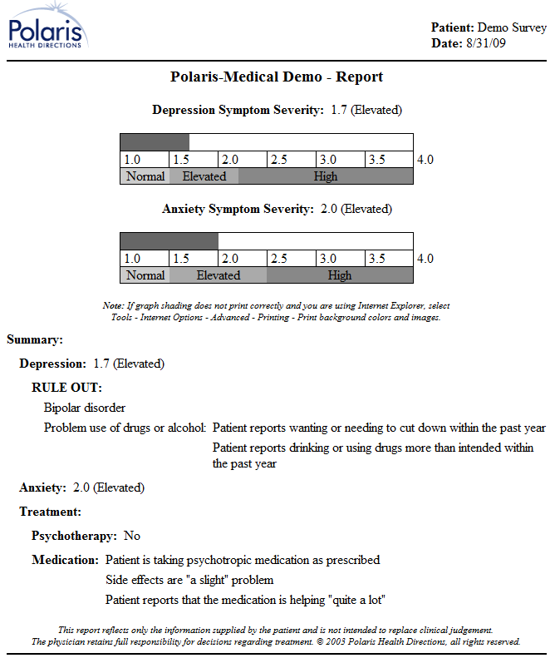
An example system to support drug and alcohol counseling
http://cf.polarishealth.com/demo/start_demo.html

Slide 38
Requirements
Requirements definition, functional reqs, unstructured text
Requirements definition, non-functional reqs, with fit criteria
UC#1: Survey and report
Class diagram of entities
Requirements definition: written from external viewpoint; system is like a “black box”

Slide 39
Requirements definition, functional reqs, unstructured text
Before each counseling visit, each counselee takes a survey.
After each survey, the system prints a report showing the counselee’s progress.
Administrative assistants can add counselees and their counselors to the system.
Requirements definition: written from external viewpoint; system is like a “black box”

Slide 40
Requirements definition, non-functional reqs, with fit criteria
Each survey will be short enough for an average user to complete within 10 minutes.
Progress reports will each be 2 pages or less.
The system will print progress reports within 2 minutes of a survey’s completion.
Users can take a survey using a Windows machine that has a Pentium II 550 MHz CPU, with 0.5 GB of RAM.
Requirements definition: written from external viewpoint; system is like a “black box”

Slide 41
UC#1: Survey and report
Actor: Counselee
Precondition: Counselee registered in system
Postconditions:
Counselee progress data is recorded in system
Report is printed for use by counselor
Flow of events:
Counselee logs in (lastname + PIN)
System collects survey data from counselee
System prints report

Slide 42
Class diagram of entities
User
+ lastname (string)
+ PIN (int)
Report
+ surveys
+ counselor
*
Counselor
+ reports
1
*
1
*
Survey
+ questions (String [])
+ answers (int [])
+ counselee
Counselee
+ counselor
+ surveys
*
*
1

Slide 43
Requirements
Requirements specification, functional reqs, unstructured text
Requirements specification, non-functional reqs, with fit criteria
Data flow Diagram
Sequence Diagram
Requirements specification: written from system’s viewpoint, involving internal details of system

Slide 44
Requirements specification, functional reqs, unstructured text
The system will provide screens so that when counselee and counselor data are entered into the system, these data are transferred to a database or other permanent storage.
When survey data arrive, they will be saved and a report will be output to the printer.
Requirements specification: written from system’s viewpoint, involving internal details of system

Slide 45
Requirements specification, non-functional reqs, with fit criteria
95% of the code will be platform-independent (Java or platform-independent JavaScript).
The system will record completed surveys in the database within 30 seconds; reports will be sent to the printer within 30 seconds and emerge within 60 seconds.
Requirements specification: written from system’s viewpoint, involving internal details of system

Slide 46
Dataflow diagram (note: only shows UC#1)
Last name & PIN
Authenticate
Counselee
User ID
Survey DB
Health Information
Survey answers
Survey
All this patient’s answers (ever)
Pick up
Create report
Printout
Printer
Postscript
Printout
Counselor

Slide 47
Message sequence diagram UC#1
Counselee
Server
Database
Printer
Log in
[survey complete]
Present question
Answer question
Record answers
Get report data
Send report to printer

Slide 48
A few general comments
These are just the basic diagrams.
Sufficient for our homework, exams, and probably 90% of what you’ll see after graduation
Fancier versions of these diagrams do exist
HW has links to tools for drawing,
BUT, it’s OK to draw diagrams by hand
As long as you respect the notation
And, at least for homework, scan it into a PDF

Slide 49
What’s next for you?
Get moving on your homework
Email me if you have questions
Every team member should be contributing
Remember: Saturday is last day to fire a teammate; must be unanimous & for a good reason

